Slide 1
Siemens in Slovakia
siemens.sk
© Siemens s.r.o. 2019. All rights reserved.

Slide 2
Siemens in Slovakia
This is a placeholder eye-catcher.
2.4 cm,
Arial Bold,
8 pt
© Siemens s.r.o. 2019. All rights reserved.

Slide 3

Werner von Siemens
1816–1892
Werner von Siemens was a responsible entrepreneur and far-sighted inventor whose name soon became a household word around the world. Far ahead of his time, he recognized and fostered the link between science and technology.
“In my youth, I dreamed of founding an enterprise of world standing comparable to that of the Fugger dynasty …”
© Siemens s.r.o., 2019. All rights reserved.
XX.XX.20XX
Page 3
Author / Department

Slide 4
170 years of innovation
Milestones
1983
First magnetic
resonance imaging scanner goes into operation
2012
Test operation of the world’s largest rotor
for offshore wind
turbines
1866
The dynamo makes electricity part of everyday life
1959
SIMATIC makes Siemens a leader in automation technology
1816–1892
Company founder,
visionary and inventor
Werner von Siemens
Siemens innovations over the past 170 years
1847
Pointer telegraph lays the foundation of Siemens as a global company
1925
Siemens electrifies the Irish Free State with a hydroelectric power plant.
1975
Breakthrough of high-voltage direct-current (HVDC) transmission
2010
TIA Portal takes automation a stage further
2016
MindSphere presented as digitalization platform for all industries

Slide 5

Ingenuity for life
More than a slogan
“Ingenuity” stands for innovation, engineering, and genius.
For us, it also includes unity: We are united in our efforts,
and we are committed to partnering with our customers.
“For life” relates to our role in society: to make real what matters.
“Ingenuity for life” is therefore our unrelenting drive and promise to create value for customers, employees, and society.

Slide 6

Long-term work for Slovakia
More than 115 years in Slovakia for Slovakia
  In 1902, the first Siemens factory was established in Bratislava, Slovakia.
  During more than 115-year history, Siemens was a partner to the
  technological revolution of the country and society.

Slide 7
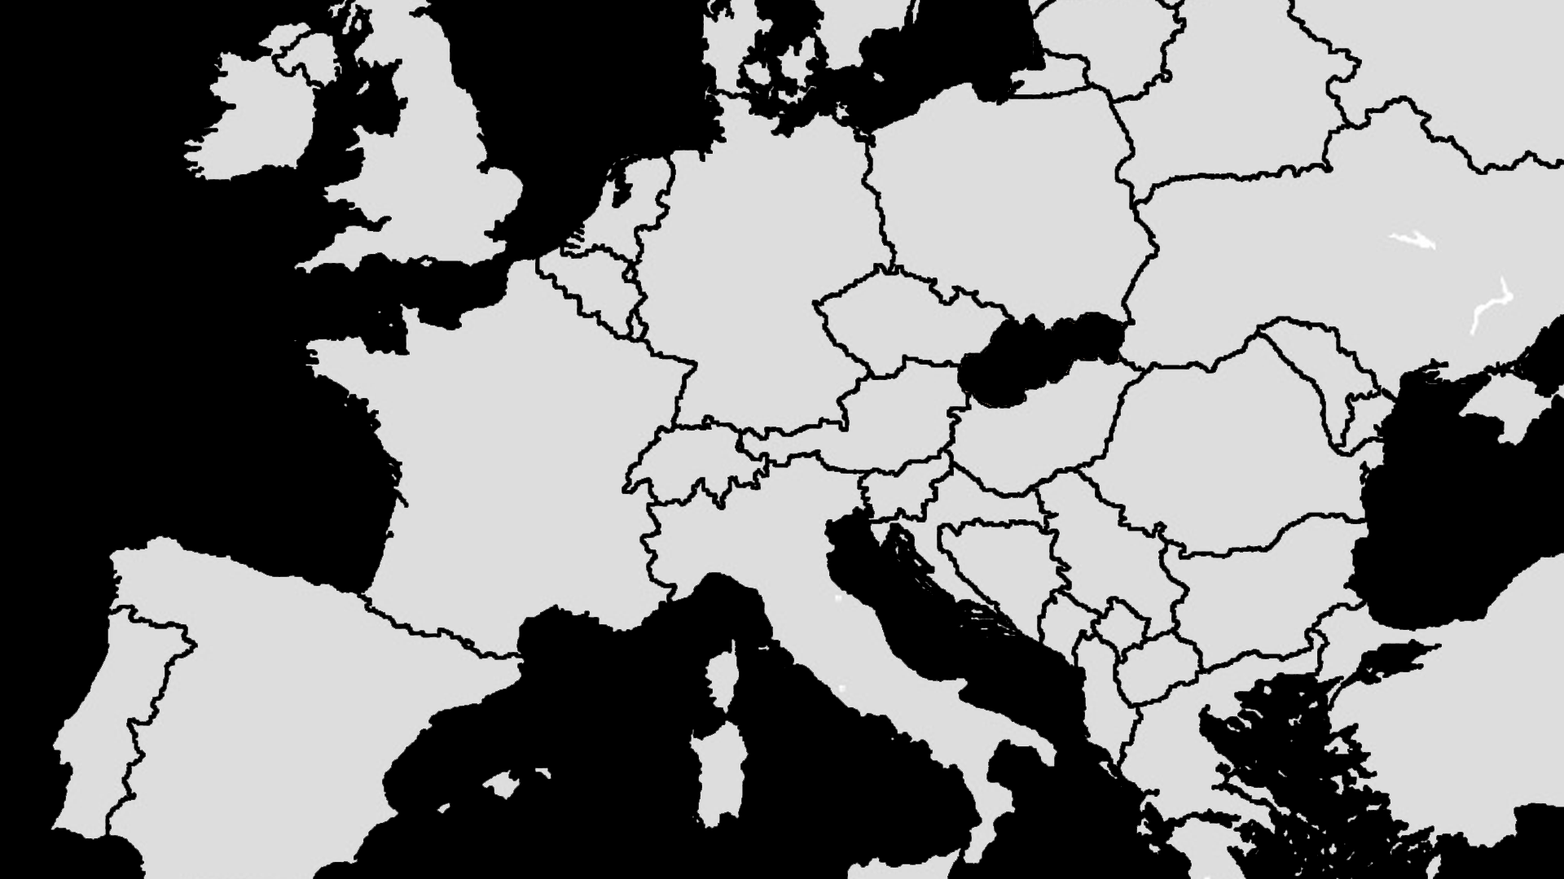
Siemens group and Slovakia
A strong local partner for our customers
49 035 km²
Area
5,439 mil.
Population
Žilina
Košice
Bratislava
€ 84,85 bn
GDP Slovakia
3,9 %
GDP growth
Siemens s.r.o. Siemens Healthcare s.r.o.
Siemens Mobility s.r.o.
SIPRIN, s.r.o.
SAT Systémy automatizačnej techniky, s.r.o.
OEZ Slovakia, spol. s r.o.
1 750
Employees on 30.9.2018
267 mil. €
Revenue
5
Companies

Slide 8
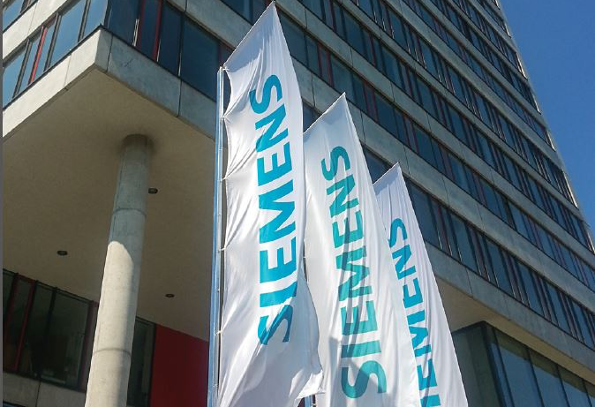
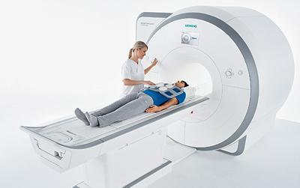
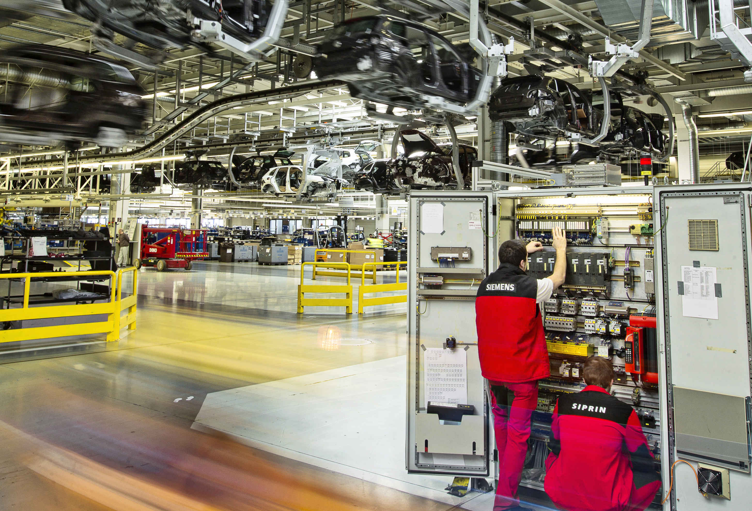
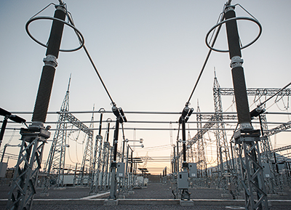
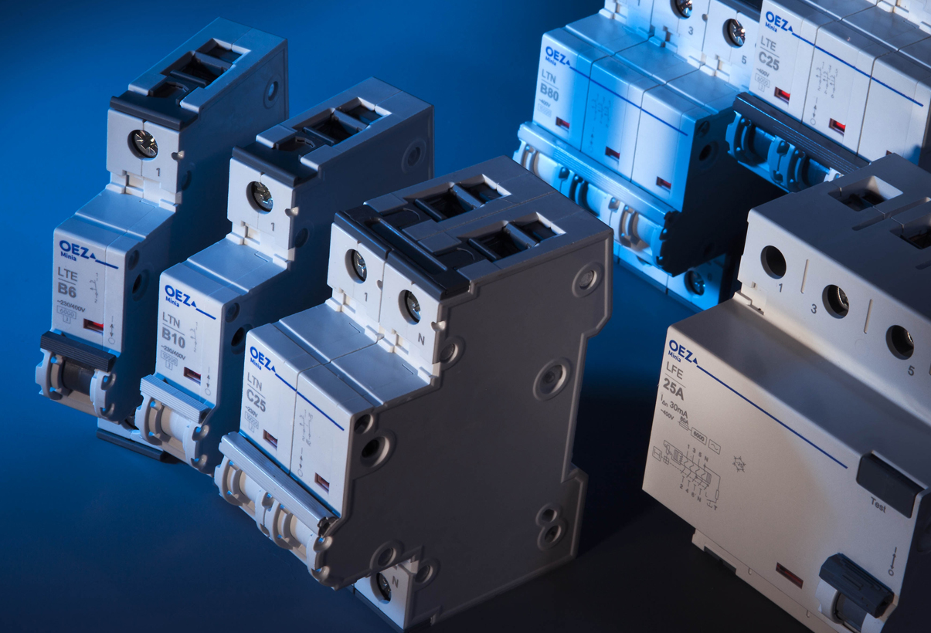
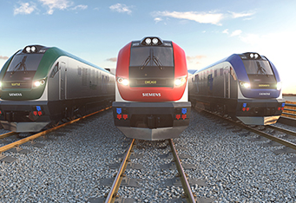
6 companies in Siemens group in Slovakia
Siemens s.r.o.
Siemens Healthcare s.r.o.
SIPRIN, s.r.o.
SAT Systémy automatizačnej techniky, s.r.o.
OEZ Slovakia, spol. s r.o.
Siemens Mobility s.r.o.

Slide 9
Siemens s.r.o.

Slide 10
Siemens s.r.o. in numbers
Key figures 2017/2018
652
Employees
230 mil. €
Revenue
11 000 hours
application trainings for customers
700 000 €
investment into the education of our employees
110 000 €
Anual contribution to CSR

Slide 11
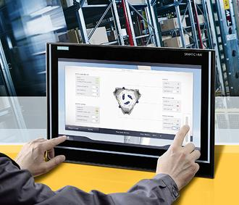
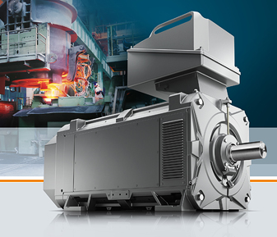
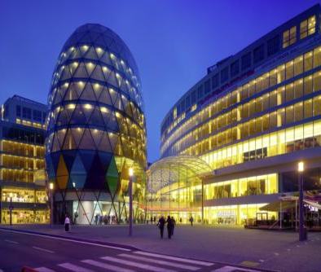

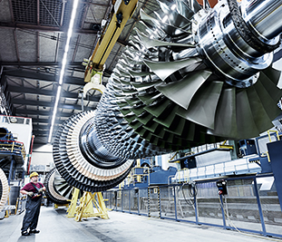
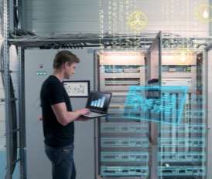
A broad portfolio of Siemens products and solutions in various fields
Digital Factory
Process Industries and Drives
Building Technologies
Energy Management
Power Generation Services
Power and Gas
Corporate Technology

Slide 12
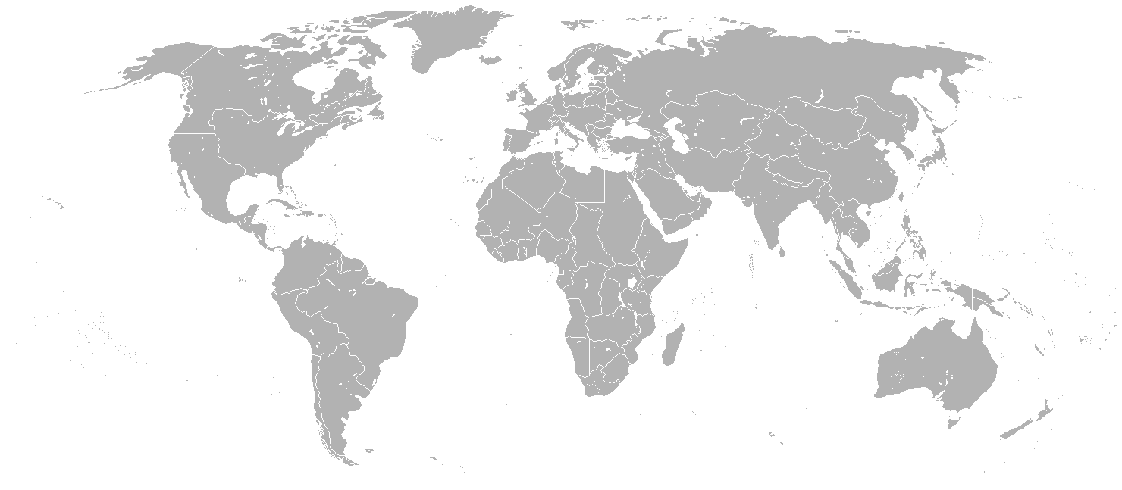
Our competence centers provide services for the whole world
Energy Management Grid Control
Energy Management Remote Engineering Centre
Treasury Back Office
HR Travel Expense Center
HR Travel Expense Center
Siemens Mobility s.r.o.
Accounting & Controlling
Accounting & Controlling
Siemens Heathcare s.r.o.
Accounting & Controlling
Siemens Mobility s.r.o.
Public Lighting
Siemens Mobility s.r.o.
Mobility Management Center of Competence, Construction Office MO Rail Systems

Slide 13

Our contribution to Industry
  Automation systems
  CNC control system
  Drive Technology
  Operator control and monitoring systems
  Siemens PLM software
  Power Supply and Industrial Controls
  Industry Services

Slide 14
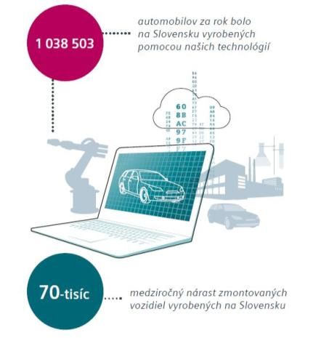
Our contribution to Industry
cars per year produced in Slovakia using our technologies
  Slovakia is one of the leading automobile manufacturers in Europe thanks to the presence of three car producers - Volkswagen, PSA Peugeot Citroen and Kia.
  All three car producers are our customers, which means that 100% of cars produced in Slovakia are assembled by Siemens technology.
1 038 503
70 000
an annual increase of assembled vehicles produced in Slovakia

Slide 15
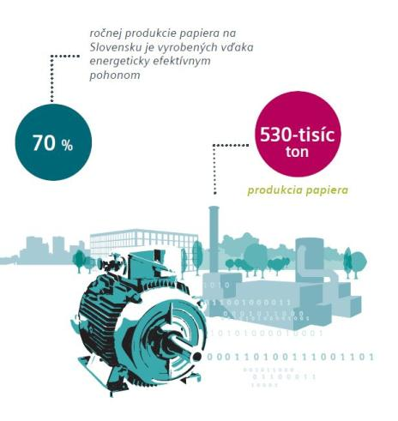
Our contribution to Industry
of annual production of paper in Slovakia is produced with energy efficient drives
  In papermaking it is very important to use efficient drives from the viewpoint of cost and ecology.
  There are three-thousand engines working day and night in the medium-sized plant.
  Modern Siemens drives are decreasing power loss by up to 40 percent compared to traditional engine.
  Up to 70% of the paper production in Slovakia is produced with energy efficient drives from Siemens.
530 k
tons
70 %
paper production

Slide 16
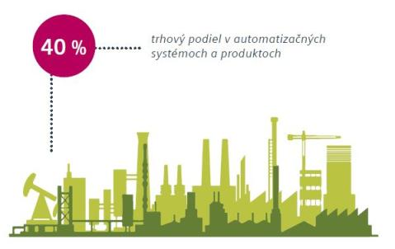
Our contribution to Industry
  Automation allows the Slovak industry to increase its competitiveness, and thus greatly contribute to economic growth and employment.
  Siemens automation systems and products, including drives for industrial automation have 40 percent market share in Slovakia.
40 %
market share in automation systems and products

Slide 17

Our contribution to Energy
  Power generation
  Power transmission and distribution
  Energy automation
  Communication systems
  Controlling systems
  Smart grid

Slide 18
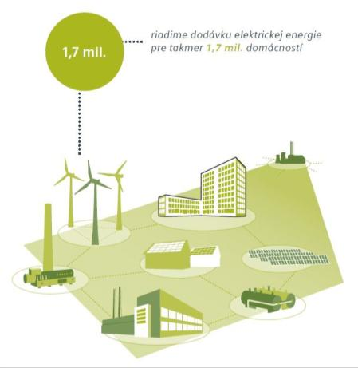
Our contribution to Energy
  Reliability of electricity supply is essential for companies and households. Siemens plays a key role in managing the supply.
  Our technologies participate in electricity supply management for 70% of the population, representing almost 1.7 million households.
Siemens manages the electricity supply for nearly 1.7 million. households
1,7 mil.

Slide 19
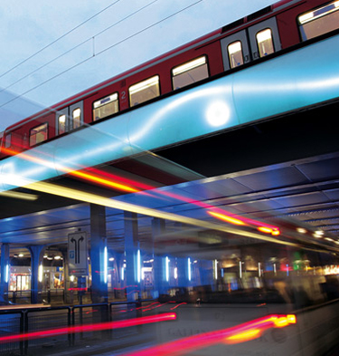
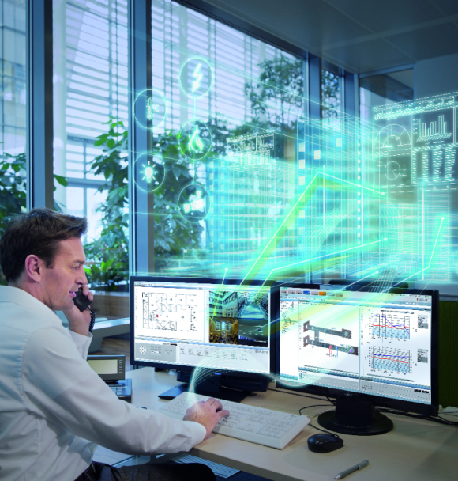
Our contribution to building technologies
  Building automation
  Building solutions
  Fire safety
  HVAC Products
  Energy efficiency

Slide 20


Our contribution to public safety
  Our fire and safety systems in workplaces, hotels and theaters protect more than 50 000 people.
  We care about the fire safety of the passengers on the 13 kilometers of highway and railway tunnels.
50K
people under protection of fire and safety systems

Slide 21
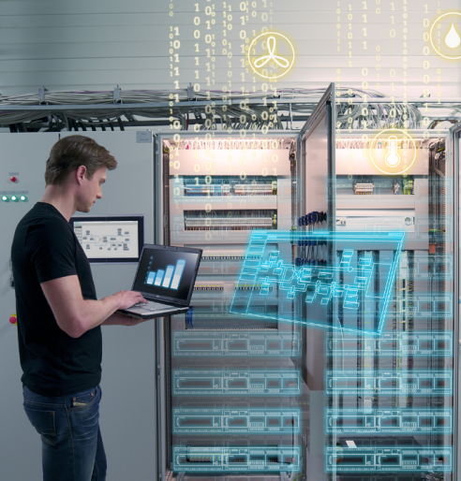
Our contribution to IT
  Siemens Corporate Technology focuses on software development of solutions for manufacture automation and control, building automation and rail transportation
  it covers development of software platforms for Industry automation and takes part in developing SCADA products, e. g. WinCC Open Architecture
  also it develops software for intelligent buildings, which controls building energy efficiency, fire security and HVAC products (heating, ventilation
  and air conditioning)
  for iOS/Android platforms Siemens Corporate Technology develops mobile applications with customer solutions in Total Room Automation
  it implements simulation systems and projects in Rail Urban Transportation

Slide 22
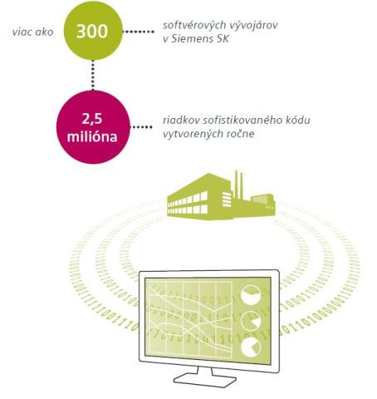
Our contribution to digitalization
300
  Siemens and Siemens Healthcare in Slovakia employ more than 300 software specialists who develop software for building technologies, industry, transport, energy and for medical care.
  Siemens employs 17,500 developers worldwide and belongs to one of the leading global players in IT.
more than
software developers
in Siemens Slovakia
2,5
millions
sophisticated lines of code created per year

Slide 23
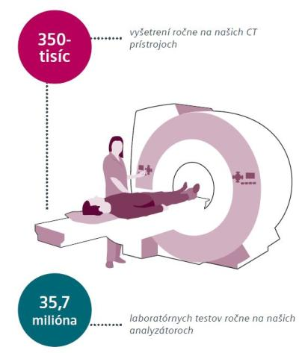
Our contribution to medical care
  Our technology helps save life with the fastest scanner, that have rotation time of only 0,33 seconds.
  More than 350 000 examinations made on our computer tomographs annually in Slovakia.
  35 700 000 medical laboratory tests made on Siemens Healthcare analyzers annually in Slovakia.
  Siemens Healthcare as the single supplier guarantees the arrival of service technicians at the hospital within two hours thanks to service centers across the country.
350 000
CT examinations annually
35,7
millions
laboratory tests made on our analyzers annually

Slide 24
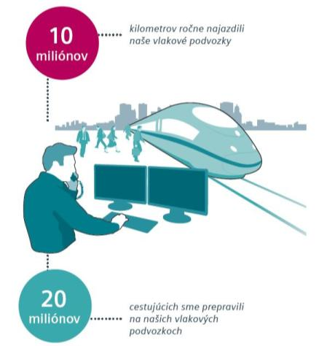
Our contribution to the transport infrastructure
  Siemens chassis are built in more than 300 train units with the annual mileage of 10 million train-km that transport nearly 20 million passengers a year.
  Implementation of our technologies will shorten the transport time by train between Bratislava and Žilina of 30 minutes.
  Our system controls the transport of more than 250 traffic lights in Slovakia. Around 9 million cars passes these traffic lights daily.
10
millions
kilometers driven by our train carriages annually
20
millions
passengers transported
on our train carriages

Slide 25
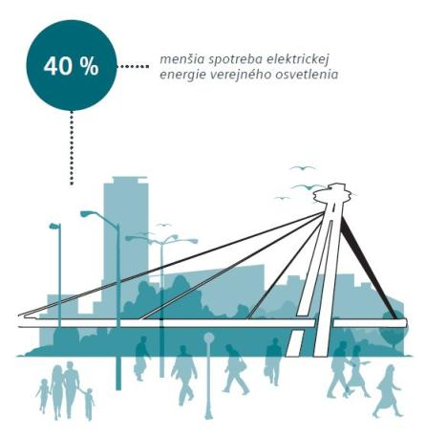
Our contribution to city infrastructure
  Our technologies provide public lighting for one million inhabitants in Slovak cities
  The functionality of the public lamps increased from two-thirds to almost 100% under the management of public lighting in Bratislava by our company.
  During 20 years of operation of public lighting in Bratislava we have reduced electricity consumption by 40% despite an 20 % increase in the number of light points.
40 %
lower power consumption
for public lighting

Slide 26
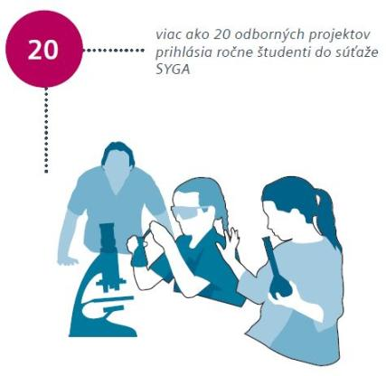
We care about social responsibility
  Together with Volkswagen, Matador and Bratislava region we opened a private high school inspired by German dual education system. Up to 70% of the entire study consists of practical training. Students in Dual Academy are preparing for work with robots and automation systems in automotive industry.
  We organize competition Siemens Young Generation Award for 15 years in Slovakia. The goal is to help students gain practical experience in the field of automation solutions.
  We have supported Slovak Universities with the amount of 30 000 €.
20
number of projects submitted to the students competition Siemens Young Generation Award annually.

Slide 27
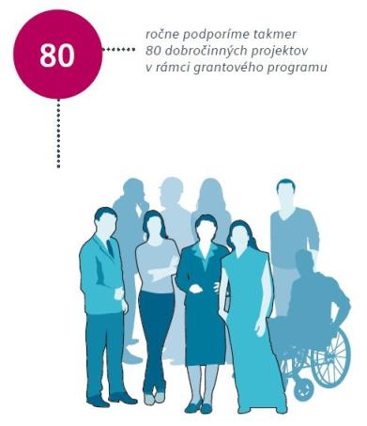
We care about social responsibility
  Together with the Volkswagen Foundation, we donated the new ultrasound ACUSON Freestyle, totaling € 80,000, to the National Institute of Children Diseases, which will contribute to better and more comfortable diagnosis of children
  Within the Employee grant program in cooperation with Center for Philanthropy employees suggest social projects to be granted. Totally 79 projects in amount of 30 000 EUR have been supported in 2018.
  Our employees donated Christmas gifts to 280 children in crisis centers and families in need across the country. The project Tree of wishes was realized for the 5th time this year in Bratislava, Žilina and Košice together with partner companies.
79 charitable projects supported within the Employee grant program in 2018
79

Slide 28
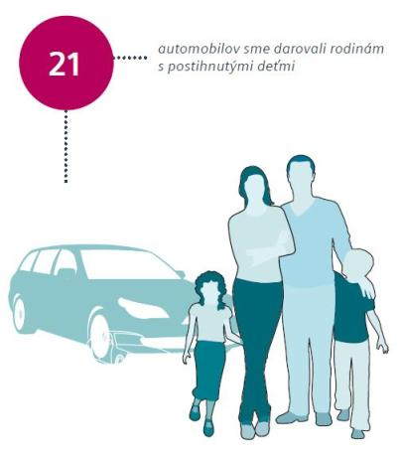
We care about social responsibility
  Depreciated company cars have been donated to 21 families with disabled children across the country, which significantly helped to improve their quality of life.
  We actively engage in the fight against breast cancer, from which suffers one in 10 women in Slovakia. We prepared the awareness campaign, that focused on prevention and provided free preventive oncology examination for hundreds of female employees of Siemens and selected business partners.
  We donated top robotic ultrasound device to St. Elizabeth Cancer Institute in Bratislava. The ultrasound pushes diagnosis of breast cancer at a higher level.
21
cars donated to families with disabled children

Slide 29
In Slovakia, for Slovakia
siemens.sk
© Siemens s.r.o. 2016. All rights reserved.

